Slide 1
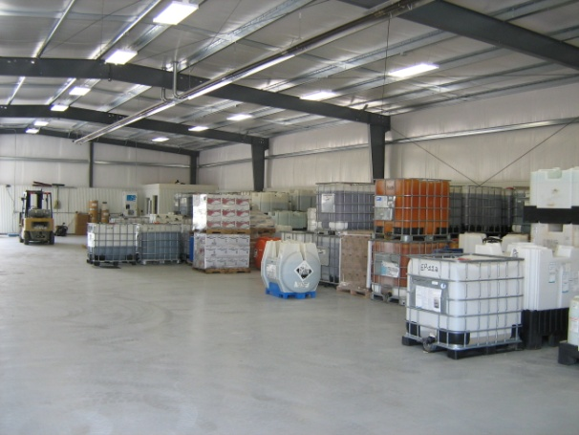
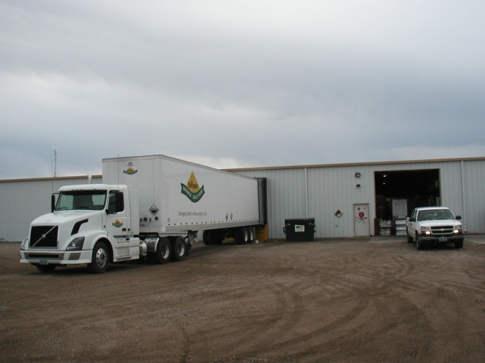
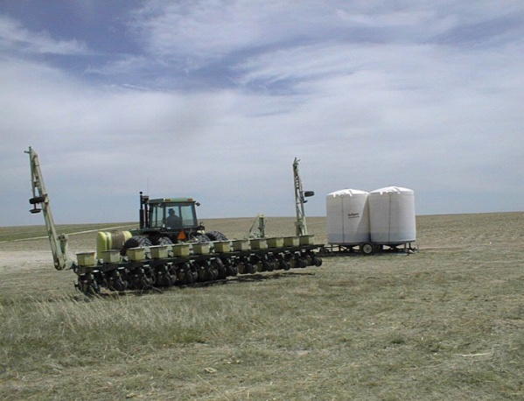
Rinsate Management Problems & Solutions
Why Generate Rinse?

Slide 2
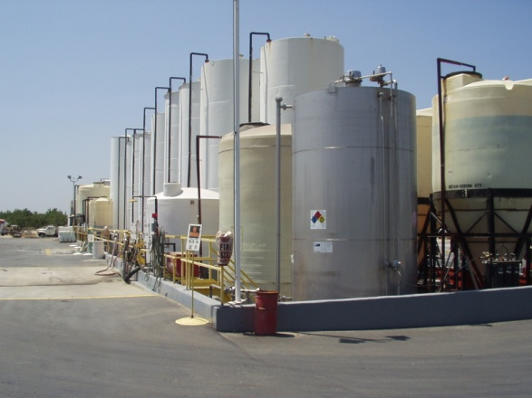
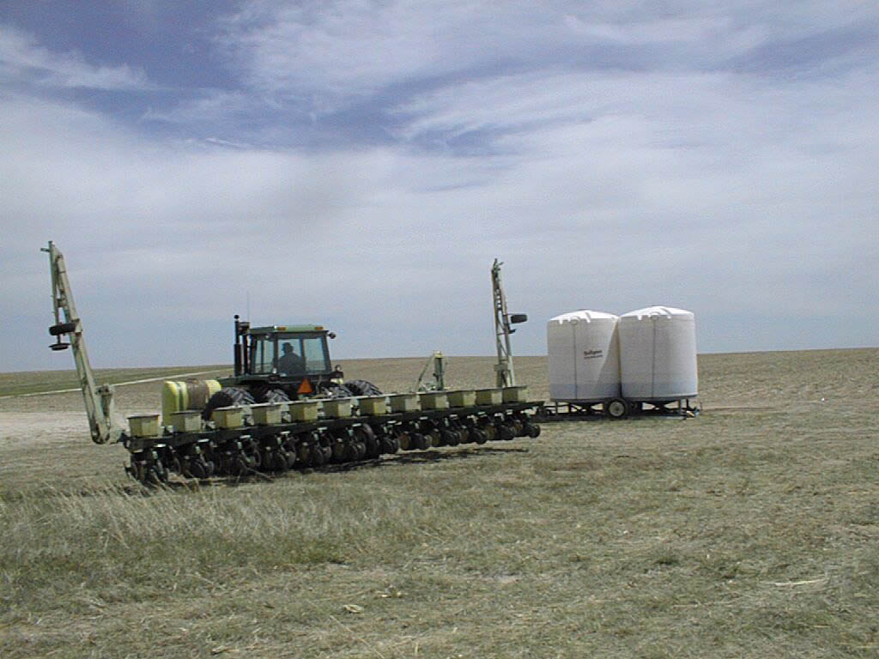
Refilling vs Rinsate Management
Notes:
Discuss:
#3 Containment, Tank and Tank Appurtenance Inspection
#3 Maintenance Records
#3 Container and Containment Rules
#4 Assure that employees secure their loads; spot check.
#4 When loading; be cautious around valves, assure that they aren’t in jeopardy of being broken/damaged (i.e. sticking out beyond the bed or gates).

Slide 3
Rinsate Management History 101

Slide 4
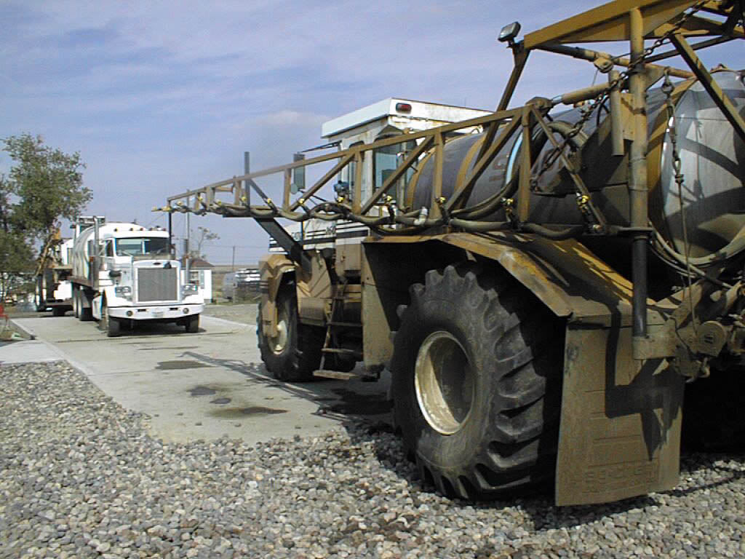
“Pounds on the Ground”

Slide 5
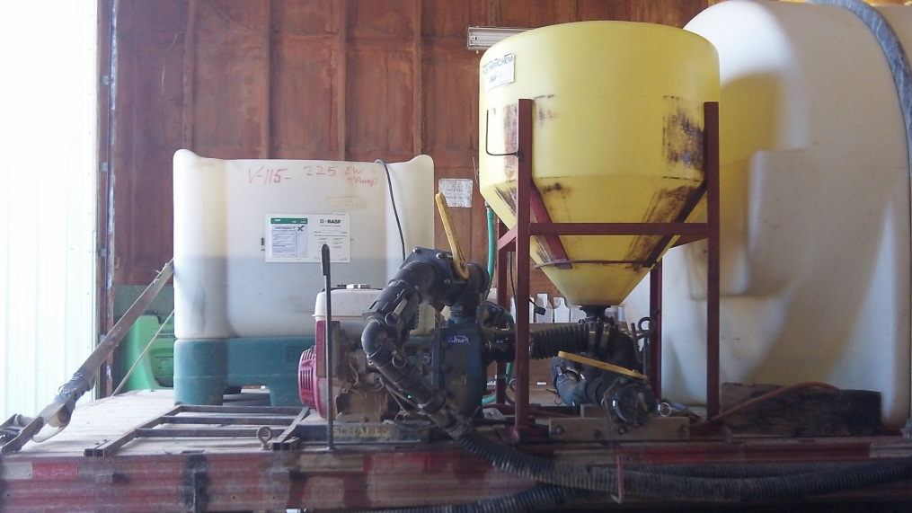
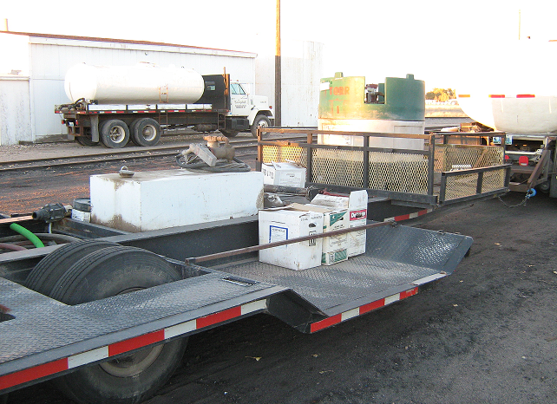
“Tools of the Trade”

Slide 6
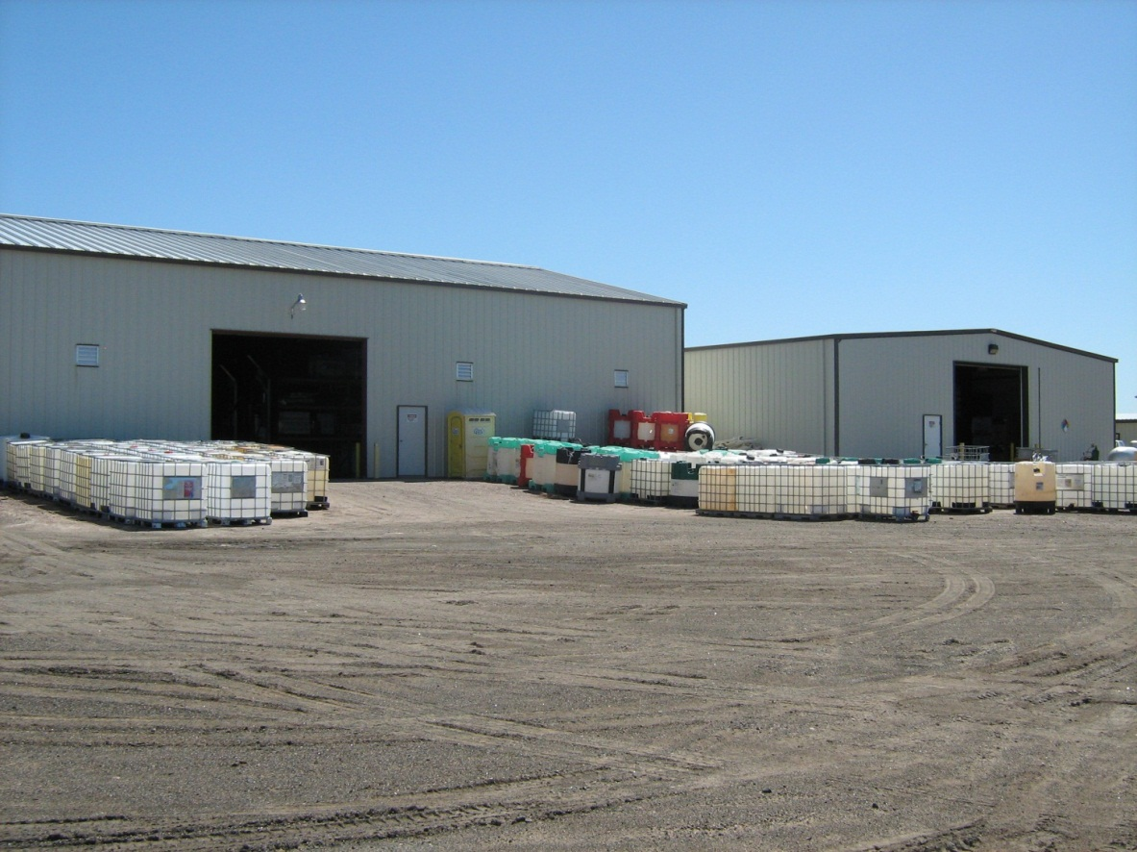
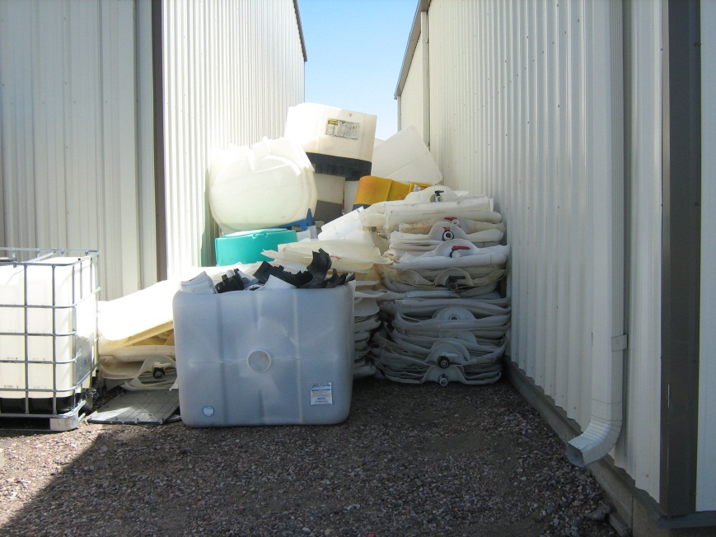
Aesthetics vs Logistics

Slide 7
They mix and load How?

Slide 8
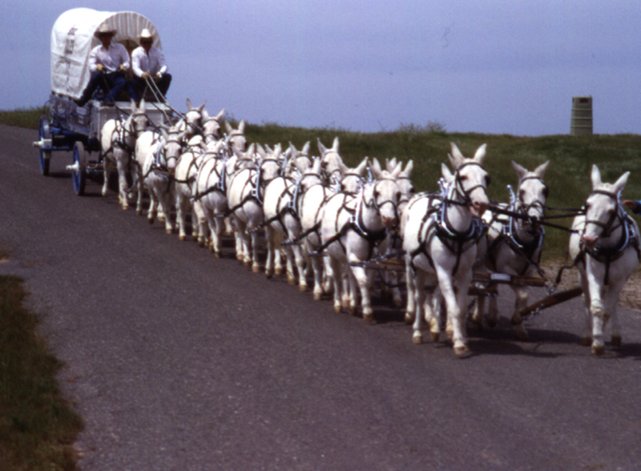
Everyone needs to head in the right direction!

Slide 9
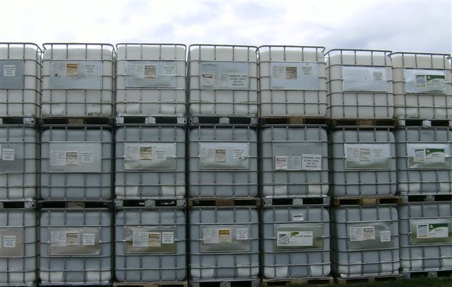
QUESTIONS?

